Slide 1
Cyber Risk Detection in Teenage Internet Usage Patterns

Slide 2
Objective
The project aims to classify teenager’s online behavior activity patterns into Safe, Neutral, or Risky cybersecurity behavior categories using machine learning by analyzing device usage, online behavior, security practices, and risk indicators. The model can help identify unsafe digital habits early and support strategies for promoting cybersecurity awareness among teenagers.

Slide 3
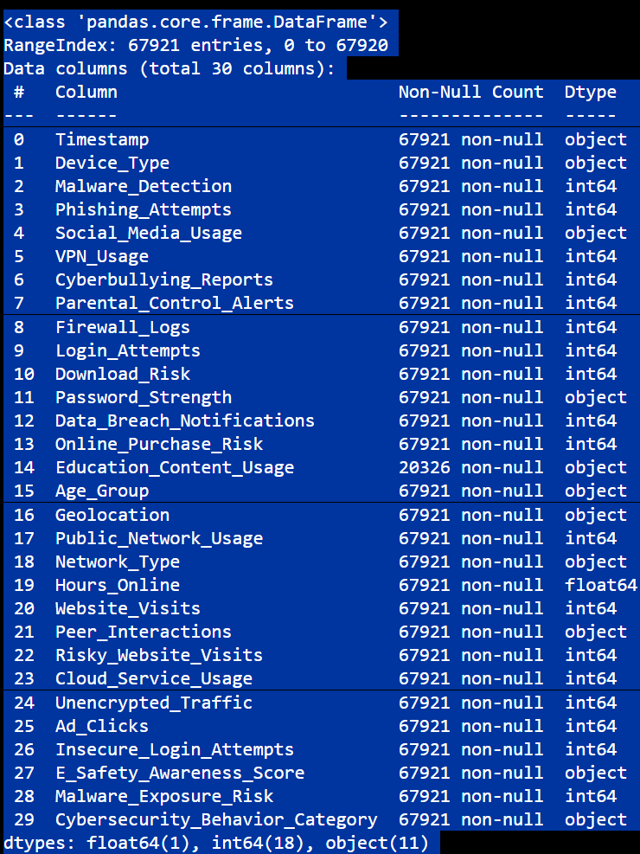
DATASET DESCRIPTION
This dataset contains 67,921 rows and 30 columns. It contains both numerical and categorical variables related to cybersecurity behaviors.
Categorical variables were encoded using Label Encoding (for target variable) and One Hot Encoding (for input features).
SMOTE was used to balance the target variable classes.

Slide 4
Data Pre-processing
Handled Null values using Fillna() Function.
Outliers and skewness was treated.
Removed unnecessary columns like timestamp and year.
Handled categorical variables using One Hot Encoding.
Applied Label Encoding for target variable.
Used StandardScaler() for feature scaling.
Balanced dataset using SMOTE.
Applied Select-K Best for feature selection.

Slide 5
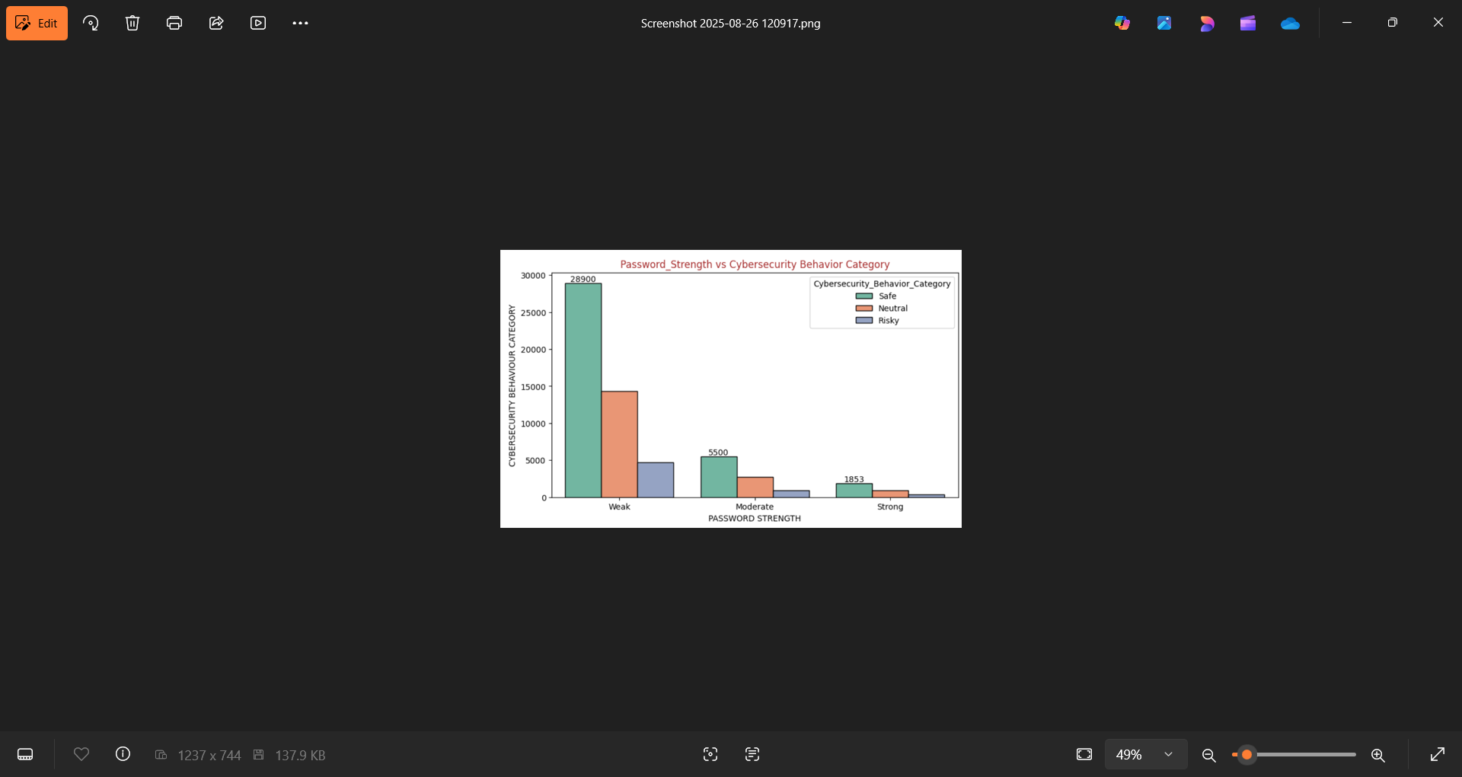
Visualizations
Most users with weak passwords fall under the Safe category, but many are also Neutral and Risky.
Very few users have strong passwords, showing teenagers often do not follow strong security practices.

Slide 6
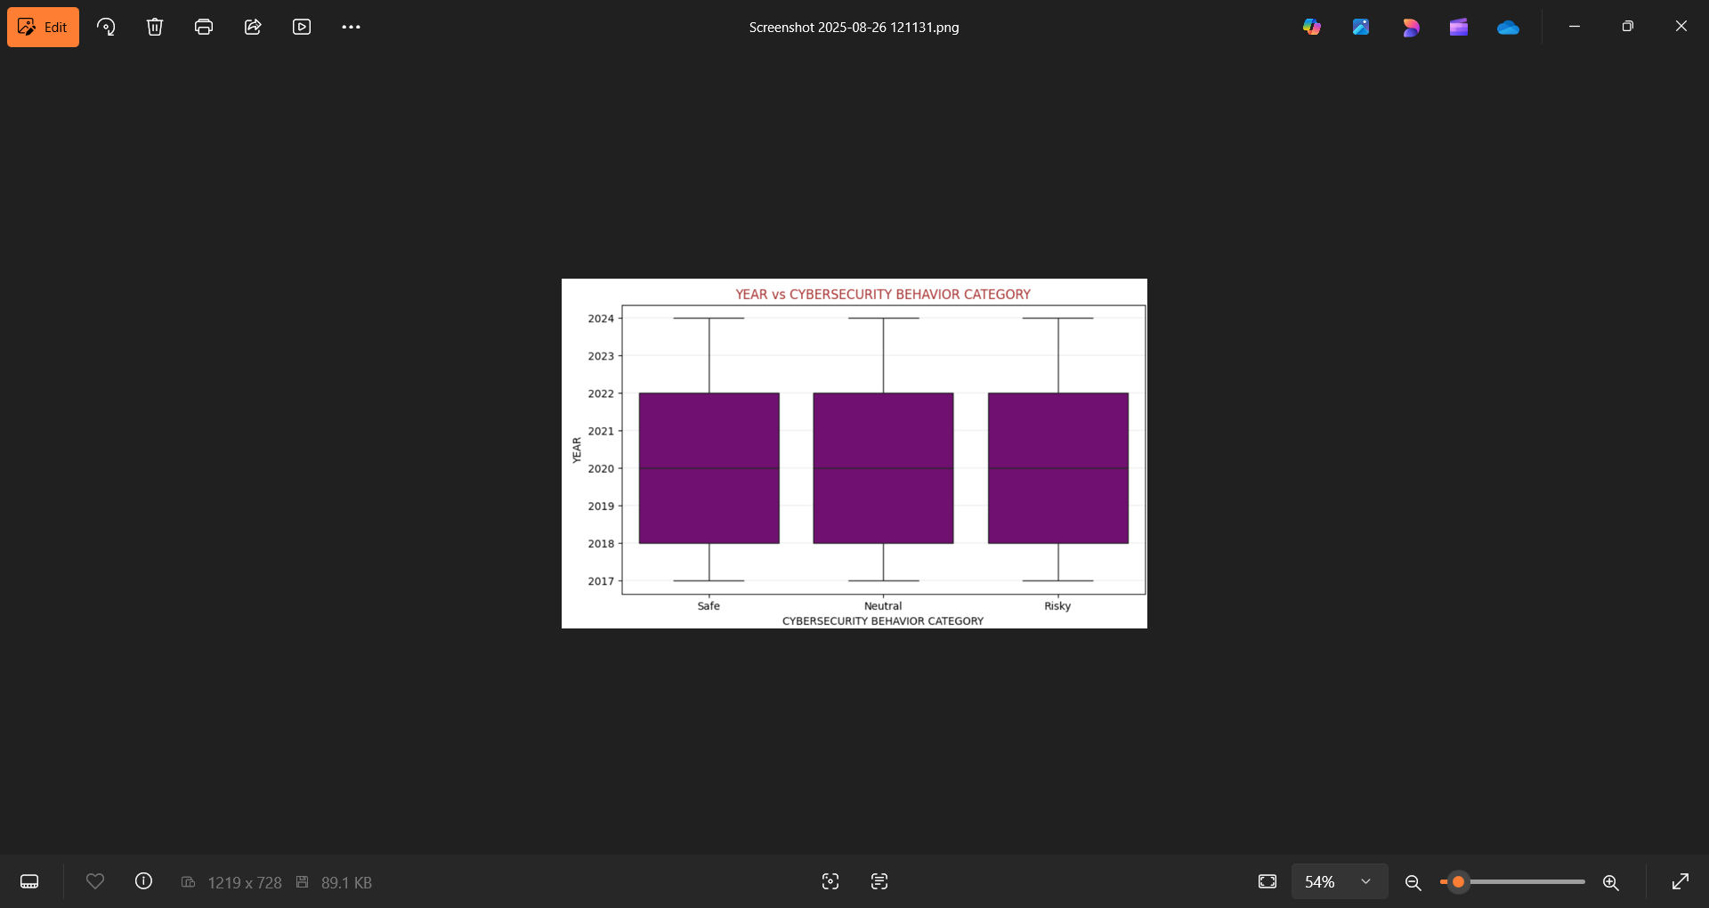
Insights
The boxplot shows that cybersecurity behaviors (Safe, Neutral, Risky) are consistent across years from 2017 to 2024.
Risky behaviors exist in all years, meaning unsafe online practices are a continuous issue.

Slide 7
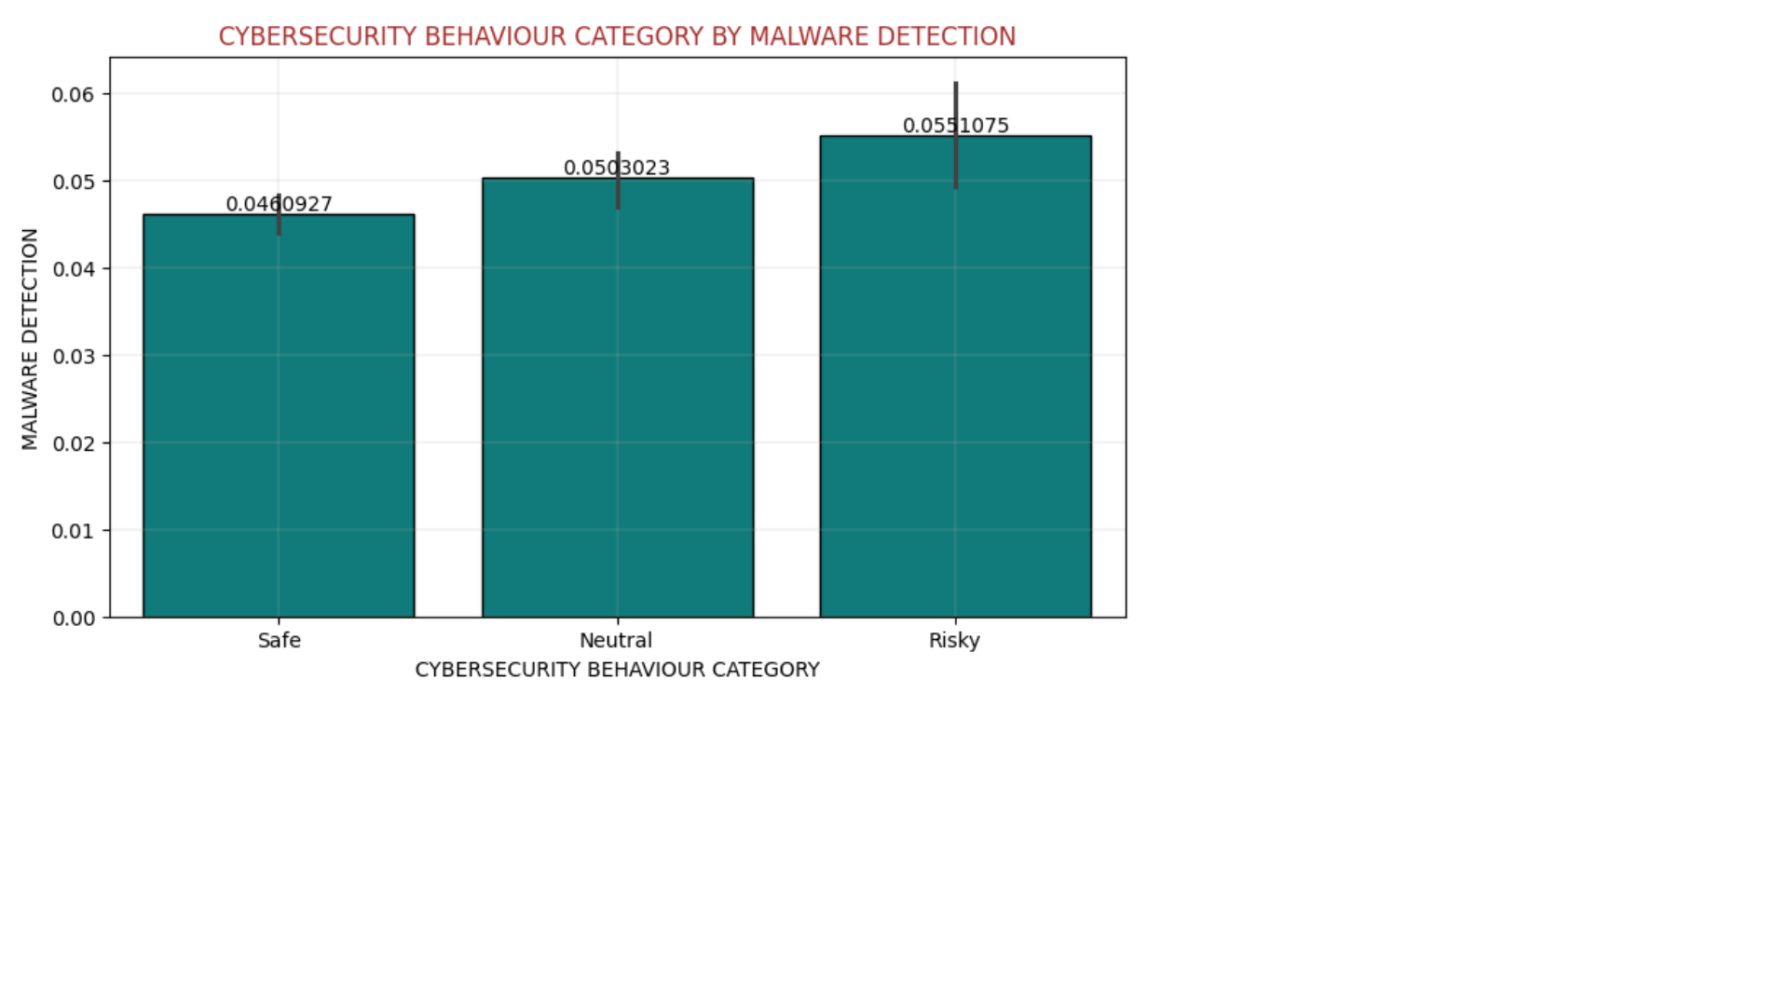
Insights
Risky users have slightly higher malware detection rates compared to Safe users.
This confirms that unsafe online behavior increases the chances of malware attacks.

Slide 8
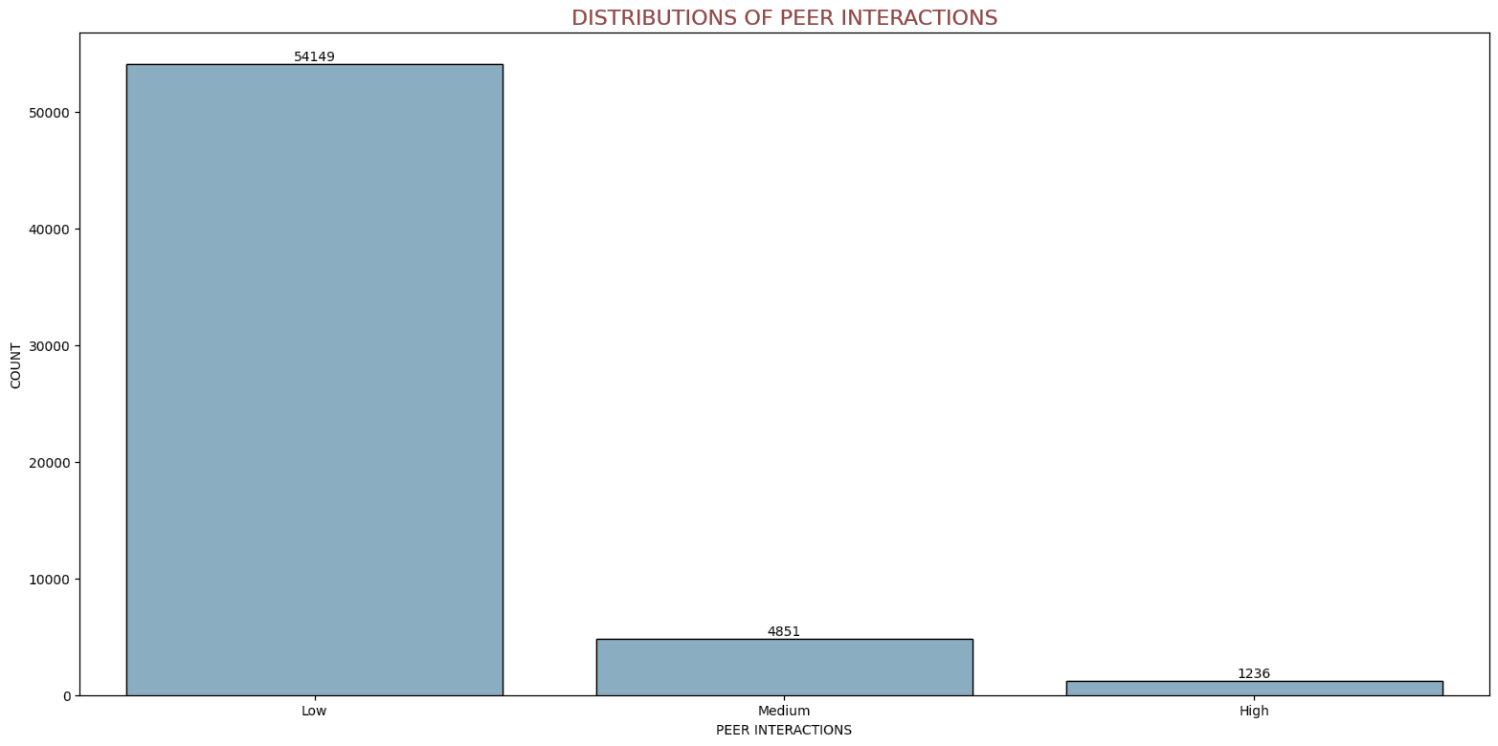
Insights
Low interactions: The largest group, with 54,149 people, meaning most individuals have very few peer interactions.
Medium interactions: Much smaller, with 4,851 people.
High interactions: The smallest group, only 1,236 people. most people have low peer interactions, while only a few have medium or high interactions.

Slide 9
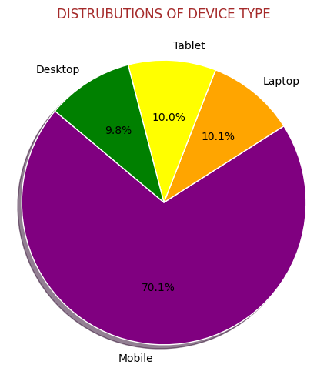
Insights
Mobile phones dominate internet usage 70%.
Laptops, tablets, and desktops together make up only 30%.
This shows mobile is the main platform for teenagers’ internet risks.

Slide 10
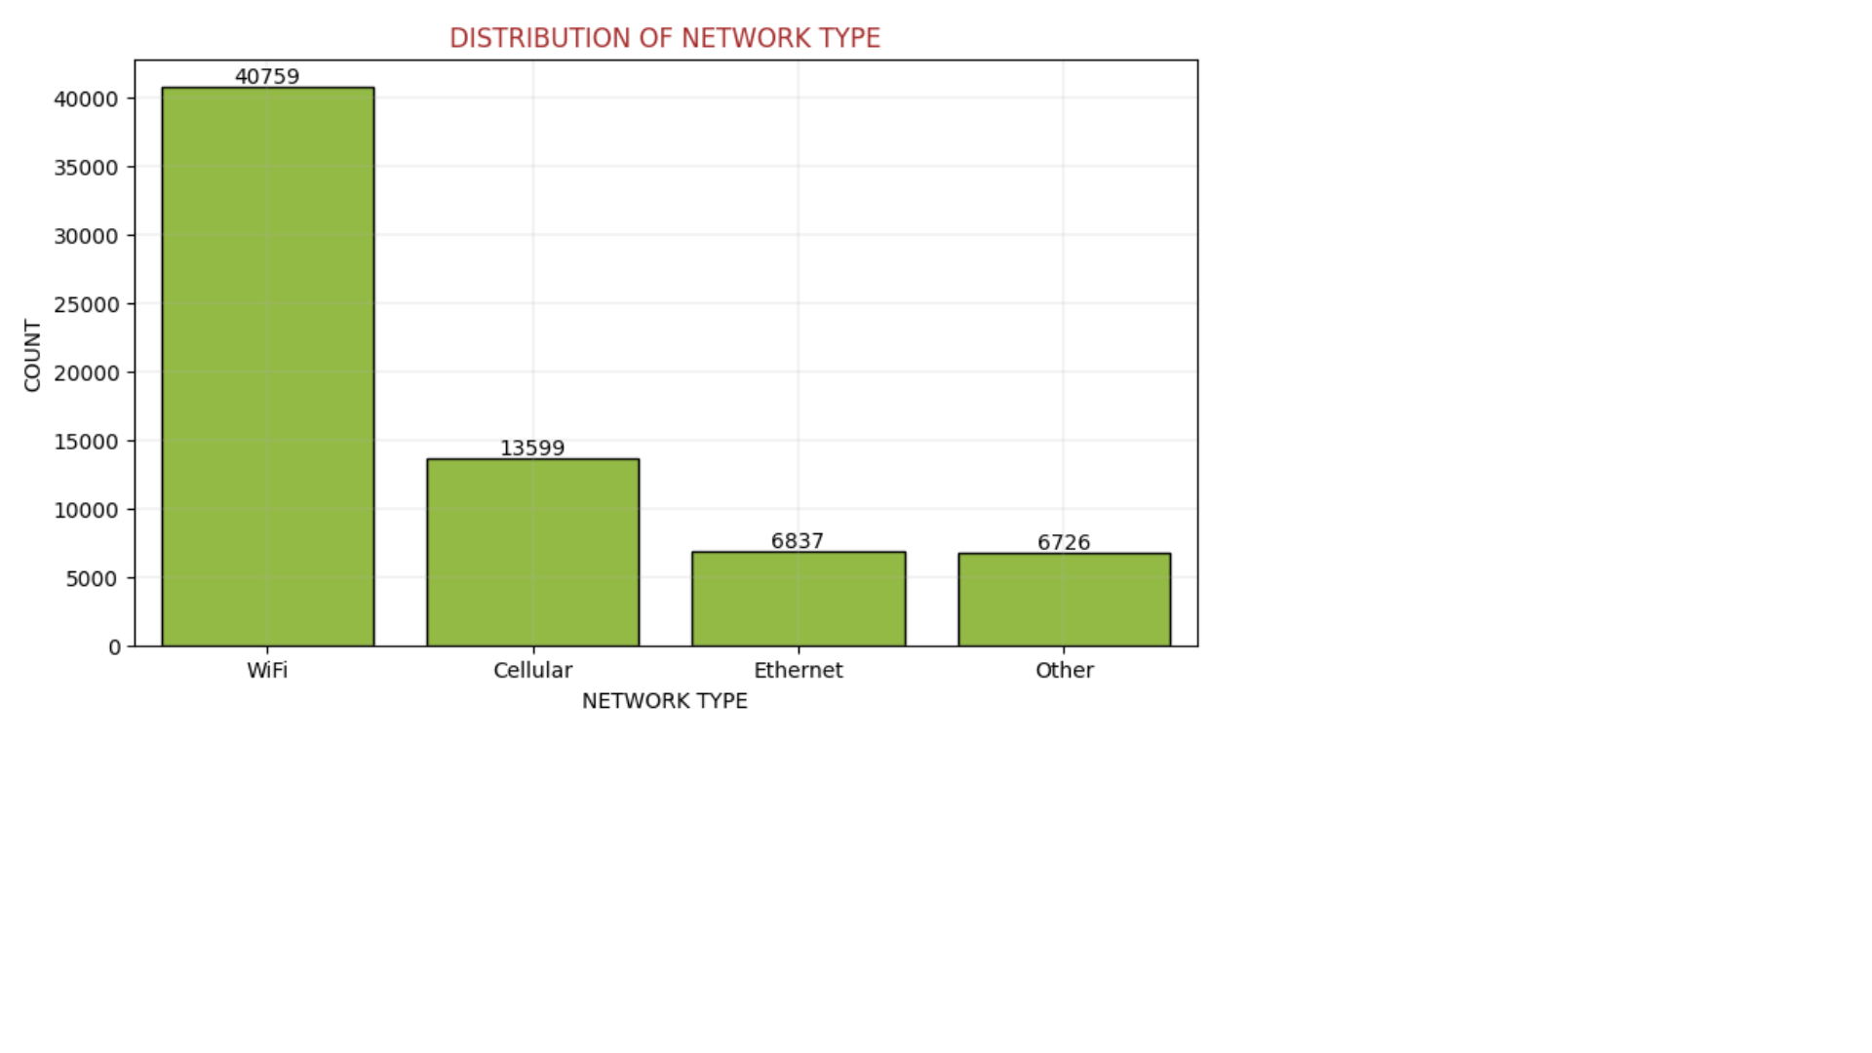
Insights
Wi-Fi is the most common (over 40,000 users), followed by Cellular.
Few use Ethernet or Other connections.
Risk exposure is higher on Wi-Fi and Mobile Networks due to frequent usage.

Slide 11
Models Used
Logistic Regression
Decision Tree Classifier
Random Forest Classifier
K-Nearest Neighbors (KNN)
XGBoost Classifier
Gradient Boosting Classifier

Slide 12
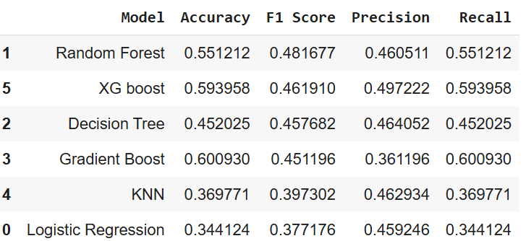
Results
This project shows that Random Forest Classifier and XGBoost Classifier performed better than other models, with moderate accuracy and F1-scores.
The use of SMOTE helped balance the classes but did not significantly boost performance.

Slide 13
Conclusion
Overall, the Project shows that the dataset is complex and requires further optimization. Future improvements can be made through hyperparameter tuning, feature engineering, and ensemble methods to achieve higher accuracy and balanced performance across all classes.

Slide 14
Thank you

